Slide 1
Creating your first PowerShell module in C#
Emanuel Palm & Justin Grote

Slide 2

Many thanks to our sponsors:

Slide 3
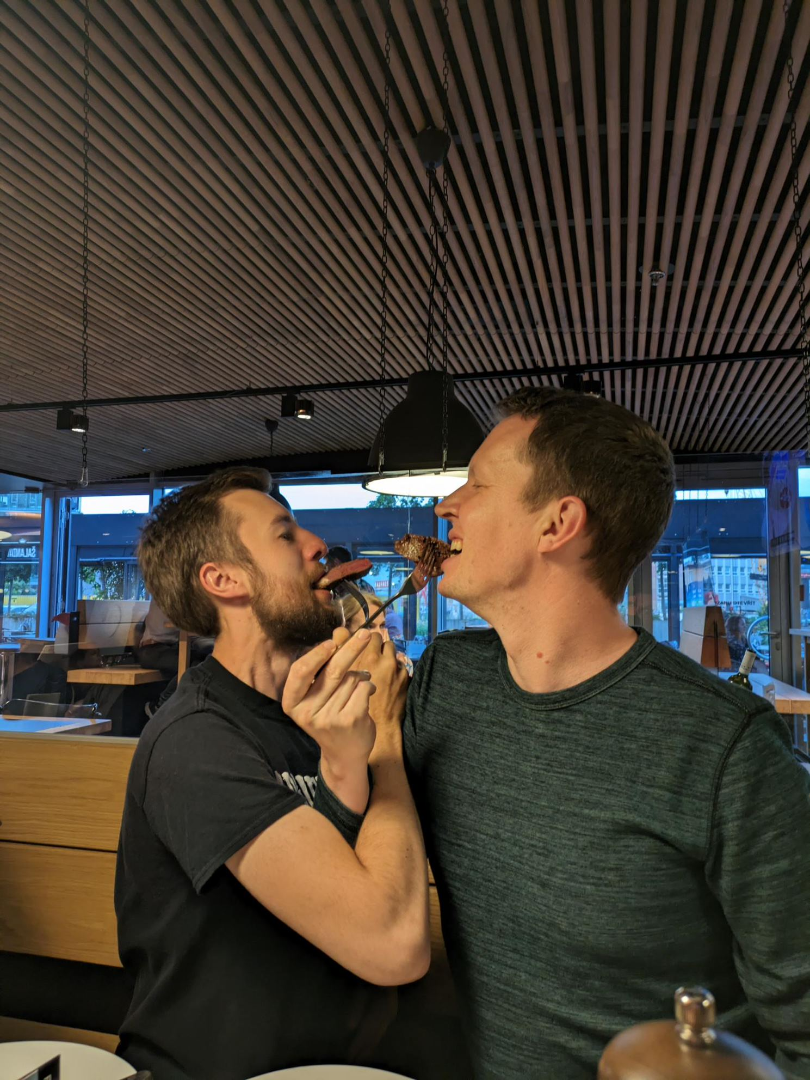


Emanuel & Justin

Slide 4

Agenda
Intro to C# module development
Tooling Options
Follow along 💻
Anatomy of a C# project
dotnet build, publish & more
Lots of code and examples!
https://github.com/PalmEmanuel/YourFirstPSModuleInCSharp

Slide 5


Slide 6
Why
Leverage the .NET ecosystem
NuGet packages and closed-source SDKs
Implement extensible APIs in a more robust way
.NET features that aren’t in PowerShell
Type safety
Generic methods
Interfaces
…

Slide 7
Useful Scenarios
Interacting with APIs that have an SDK available
Not reinventing the wheel

Slide 8
A few C# or hybrid modules
Pester
PSBicep
PrtgAPI
Most of Microsoft’s official modules
Mortar
AzBobbyTables
PoshAnywhere
More modules than you expect

Slide 9
Tooling
.NET SDK
PowerShell (Build Scripts and Interactive Troubleshooting)
Code Editor
Visual Studio Code
C# Dev Kit (Very new!)
Visual Studio (Community Edition available)
Jetbrains Rider
Any text editor
Notepad (please don’t use notepad)

Slide 10
Advanced Function vs Cmdlet
function Get-Example {
}
[Cmdlet(VerbsCommon.Get, "Example")]
class GetExampleCmdlet : Cmdlet
{
}

Slide 11
Advanced Function vs Cmdlet
function Get-Example {
[CmdletBinding()]
param()
}
[Cmdlet(VerbsCommon.Get, "Example")]
class GetExampleCmdlet : Cmdlet
{
}

Slide 12
Advanced Function vs Cmdlet
function Get-Example {
[CmdletBinding()]
param()
}
[Cmdlet(VerbsCommon.Get, "Example")]
class GetExampleCmdlet : PSCmdlet
{
}

Slide 13
Advanced Function vs Cmdlet
function Get-Example {
[CmdletBinding()]
param(
[Parameter(
Mandatory, ValueFromPipeline
)]
[String]$Name
)
}
[Cmdlet(VerbsCommon.Get, "Example")]
class GetExampleCmdlet : PSCmdlet
{
}

Slide 14
Advanced Function vs Cmdlet
function Get-Example {
[CmdletBinding()]
param(
[Parameter(
Mandatory, ValueFromPipeline
)]
[String]$Name
)
}
[Cmdlet(VerbsCommon.Get, "Example")]
class GetExampleCmdlet : PSCmdlet
{
[Parameter(
Mandatory = true, ValueFromPipeline = true
)]
public string Name;
}

Slide 15
Advanced Function vs Cmdlet
function Get-Example {
[CmdletBinding()]
param(
[Parameter(
Mandatory, ValueFromPipeline
)]
[String]$Name
)
}
[Cmdlet(VerbsCommon.Get, "Example")]
class GetExampleCmdlet : PSCmdlet
{
[Parameter(
Mandatory = true, ValueFromPipeline = true
)]
public string Name;
}

Slide 16
Advanced Function vs Cmdlet
function Get-Example {
[CmdletBinding()]
param(
[Parameter(
Mandatory, ValueFromPipeline
)]
[String]$Name
)
begin {}
process {}
end {}
}
[Cmdlet(VerbsCommon.Get, "Example")]
class GetExampleCmdlet : PSCmdlet
{
[Parameter(
Mandatory = true, ValueFromPipeline = true
)]
public string Name;
}

Slide 17
Advanced Function vs Cmdlet
function Get-Example {
[CmdletBinding()]
param(
[Parameter(
Mandatory, ValueFromPipeline
)]
[String]$Name
)
begin {}
process {}
end {}
}
[Cmdlet(VerbsCommon.Get, "Example")]
class GetExampleCmdlet : PSCmdlet
{
[Parameter(
Mandatory = true, ValueFromPipeline = true
)]
public string Name;
protected override void BeginProcessing() {}
protected override void ProcessRecord() {}
protected override void EndProcessing() {}
}

Slide 18
Advanced Function vs Cmdlet
function Get-Example {
[CmdletBinding()]
param(
[Parameter(
Mandatory, ValueFromPipeline
)]
[String]$Name
)
begin {}
process {
"Hello $Name"
}
end {}
}
[Cmdlet(VerbsCommon.Get, "Example")]
class GetExampleCmdlet : PSCmdlet
{
[Parameter(
Mandatory = true, ValueFromPipeline = true
)]
public string Name;
protected override void BeginProcessing() {}
protected override void ProcessRecord() {}
protected override void EndProcessing() {}
}

Slide 19
Advanced Function vs Cmdlet
function Get-Example {
[CmdletBinding()]
param(
[Parameter(
Mandatory, ValueFromPipeline
)]
[String]$Name
)
begin {}
process {
"Hello $Name"
}
end {}
}
[Cmdlet(VerbsCommon.Get, "Example")]
class GetExampleCmdlet : PSCmdlet
{
[Parameter(
Mandatory = true, ValueFromPipeline = true
)]
public string Name;
protected override void BeginProcessing() {}
protected override void ProcessRecord() {
WriteObject($"Hello {Name}");
}
protected override void EndProcessing() {}
}

Slide 20
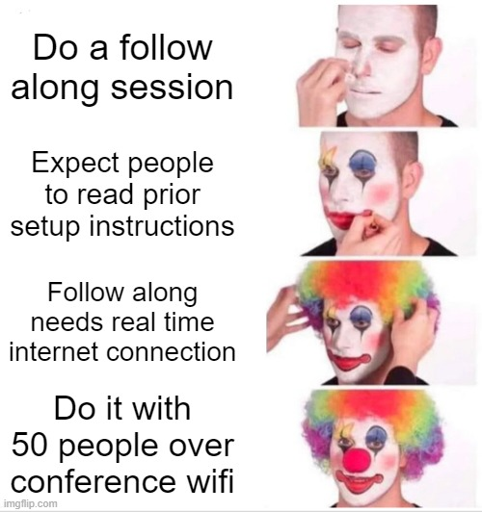

Slide 21
Follow along!
QUESTIONS:
One Hand: Questions
Two Hands: I’M STUCK!
https://github.com/PalmEmanuel/YourFirstPSModuleInCSharp

Slide 22


